Slide 1
La sfida delle competenze Tech e IT nell’Industria 4.0
Giovanni Rossi
Operation Manager Experis Academy

Slide 2

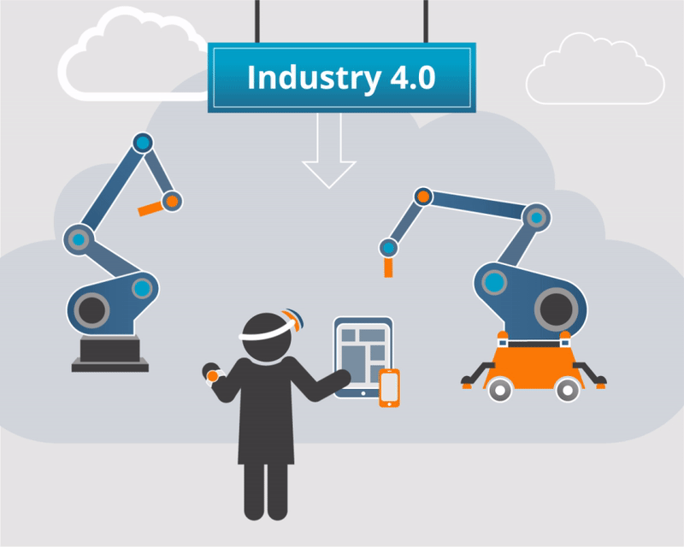
APPROACH – FOCUS ON INNOVATION
INDUSTRY 4.0 CALL HUMAN 4.0
RESKILLING
HUMAN 4.0
UPSKILLING

Slide 3

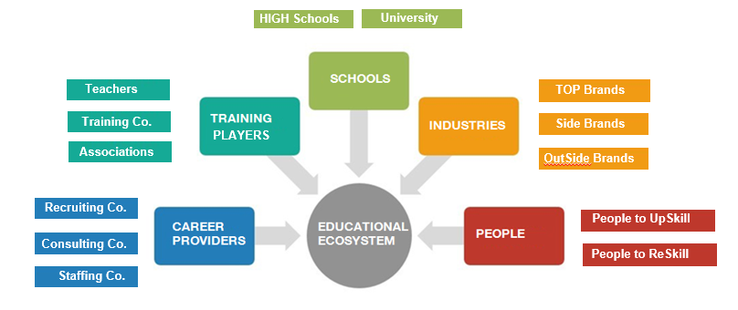
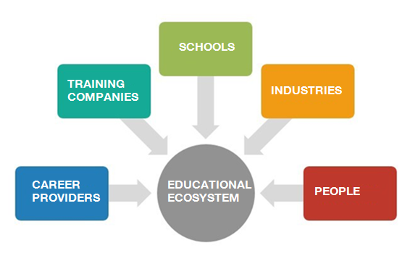
EDUCATIONAL ECOSYSTEM APPROACH
EXPERIS IMPACT
HIGH Schools
University
SCHOOLS
Teachers
TOP Brands
Training Co.
Side Brands
PLAYERS
TOP Brands
Associations
OutSide Brands
Recruiting Co.
People to UpSkill
Consulting Co.
People to ReSkill
Staffing Co.
Notes:
Bridge the gap between People and Industries

Slide 4
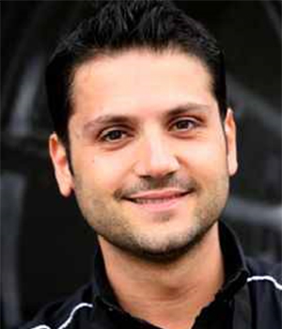
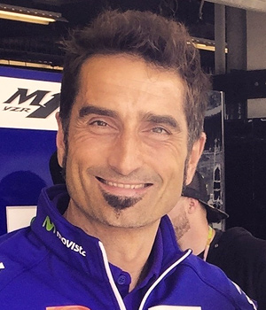




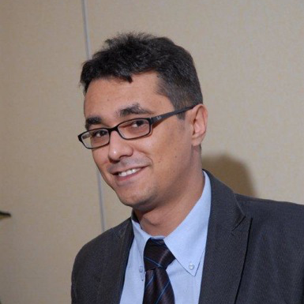

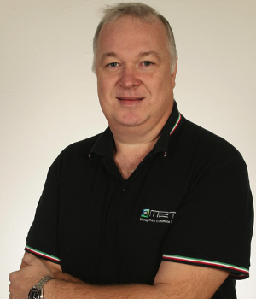
ACADEMY MODEL: TEACHERS
95% PROFESSIONALS
ALL TEACHERS ARE PROFESSIONALS FROM
MOTORSPORT, IT AND ENGINEERING.
THEIR KNOWLEDGE AND EXPERIENCE ARE AN ACADEMY TRADEMARK AND GUARANTEE A PRACTICAL APPROACH.
+50%
FROM THE PARTNERS STAFF

Slide 5



FOCUS ON:
THE ACADEMIES
MODEL VALUES
MOTORSPORT
ADVANCED MANUFACTURING
IT & ENGINEERING
MARANELLO (MO)
FORNOVO DI TARO (PR)
KILOMETRO ROSSO (BG)

Slide 6

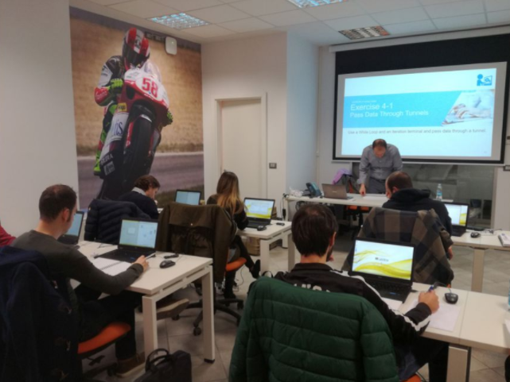
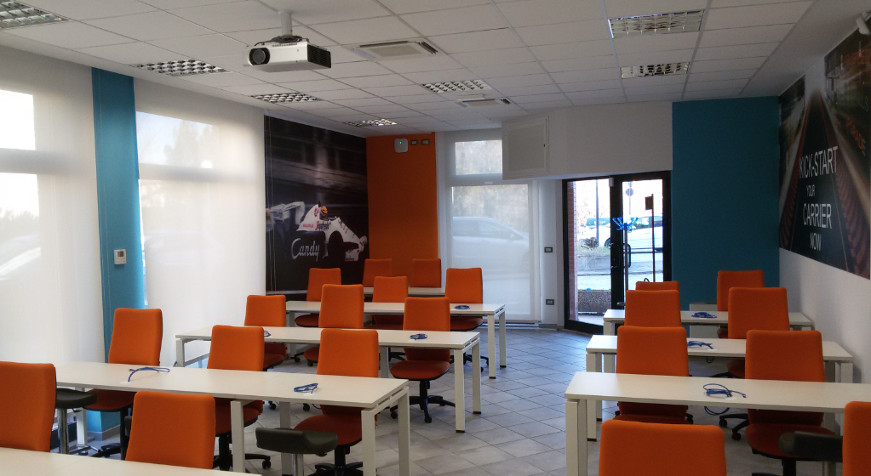
EXPERIS ACADEMY MOTORSPORT

Slide 7
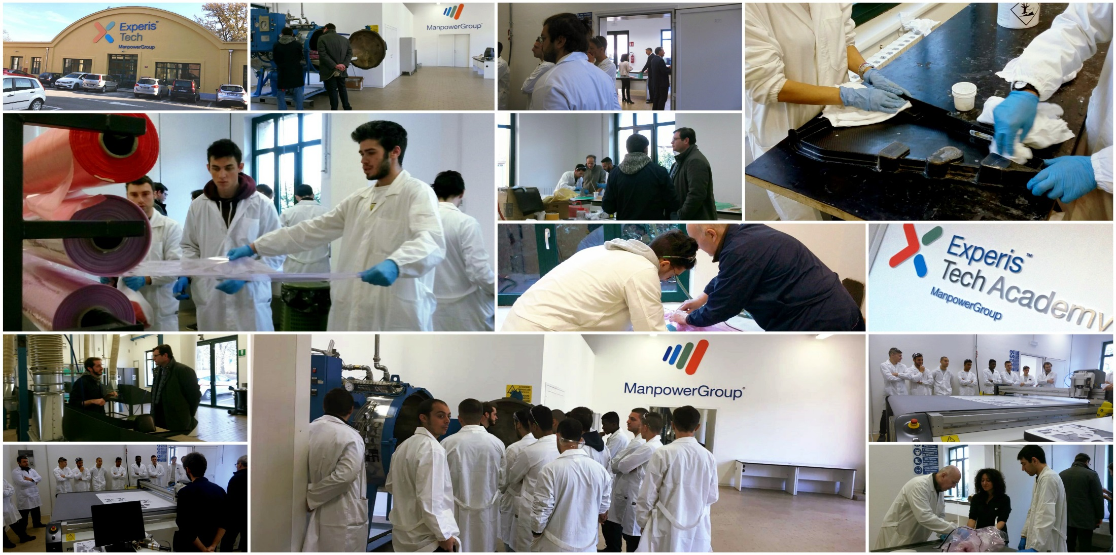
EXPERIS ACADEMY ADVANCED MANUFACTURING

Slide 8

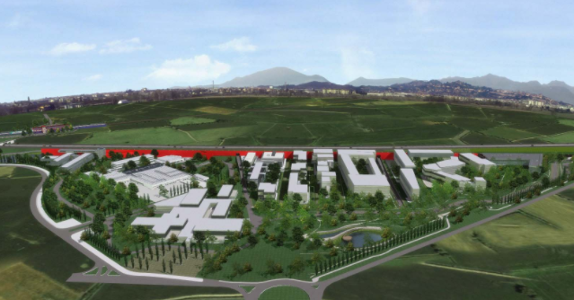

EXPERIS ACADEMY IT & ENGINEERING

Slide 9










TRAINING PROGRAMS
ROBOTICS
SYSTEM
INTEGRATION
CYBERSECURITY
INTERNET OF
THINGS
BIG DATA
AUGMENTED
REALITY
SIMULATION
CLOUD
COMPUTING
ADDITIVE
MANUFACTURING

Slide 10

RESULTS: YEARLY NUMBERS
NUMBER OF PEOPLE WHO’VE FOUND EMPLOYMENT FOLLOWING A COURSE
700 people trained annually - Placement: 70%

Slide 11


Than
GIOVANNI ROSSI
@giovannirossi74

